Slide 1
Compliance Management Awareness Campaign
Notes:
Page 1

Slide 2
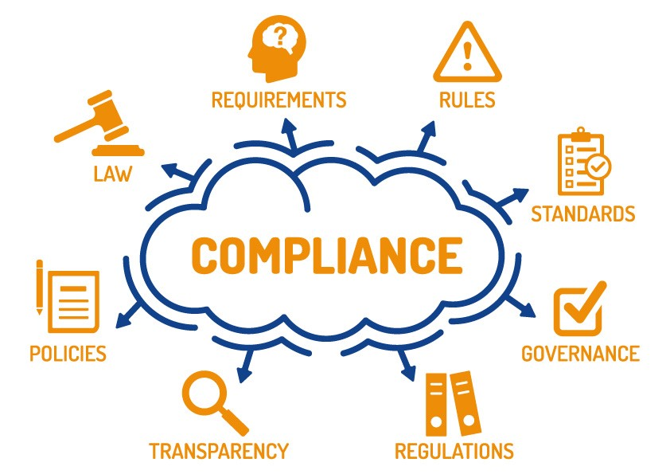
WHAT IS THE DEFINITION OF COMPLIANCE?
Compliance is to ensure that the Hospital and its employees follow all internal and external laws, regulations, policies, and procedures
2 of 19
Notes:
Page 2

Slide 3
WHY COMPLY ?
The Hospital established the Compliance Division to encourage and promote the culture of compliance in the Hospital, which means compliance is
“Every Employee’s Responsibility”
The divisional goal is to ensure compliance with all internal & external laws, regulations, and healthcare industry standards
to
Provide Safe and Quality Patient Care
4 of 19

Slide 4
RISKS ARISING FROM NON-COMPLIANCE
Non-compliance might lead to the following risks
Poor quality patient care
Financial losses
Lawsuits
Damage reputation
Security Breaches
5 of 19

Slide 5
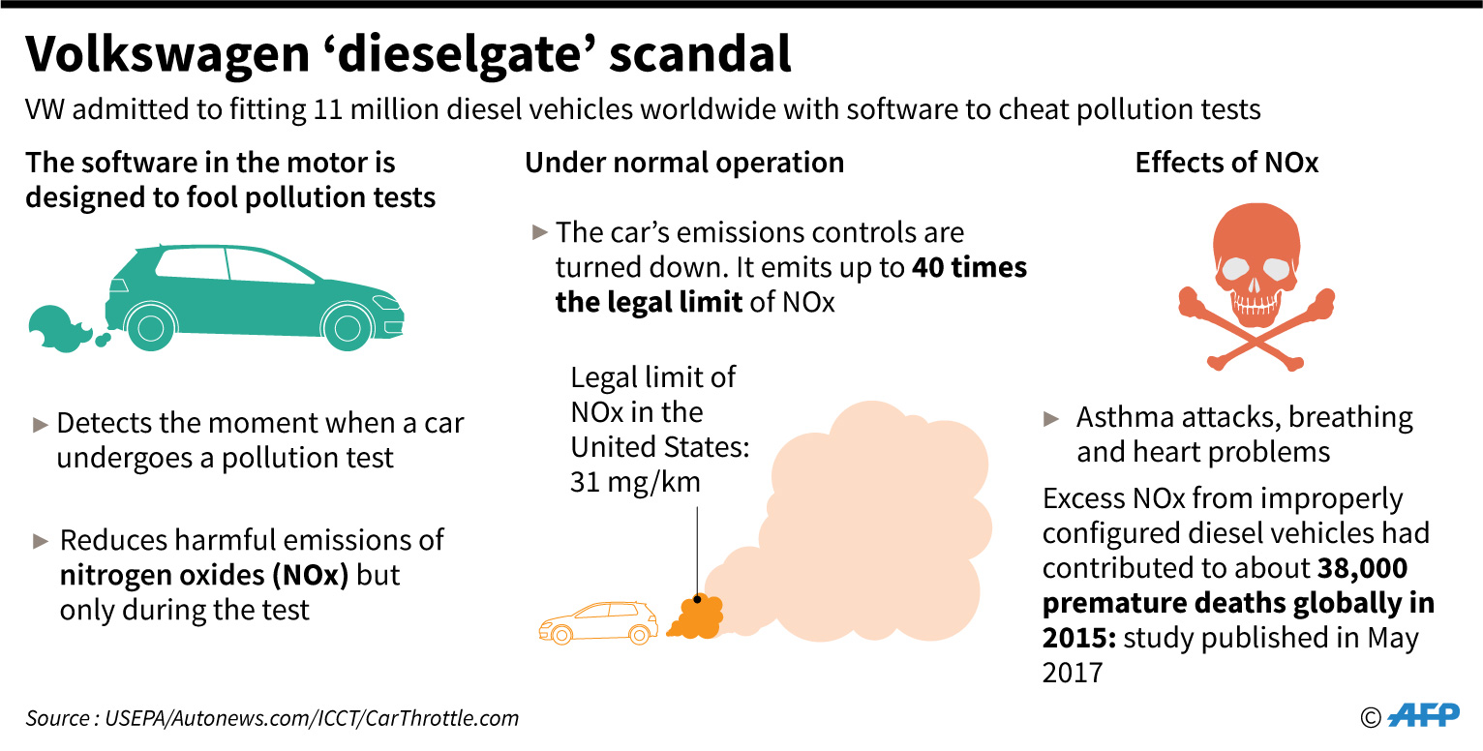
STORY 1 $ 20 BILLION FINES DUE TO NON- COMPLIANCE
Volkswagen did not comply with the US Environmental Protection Agency (EPA) regarding the diesel engine emissions which resulted in the Company’s financial loss of up to $20 Billion.
6 of 19

Slide 6
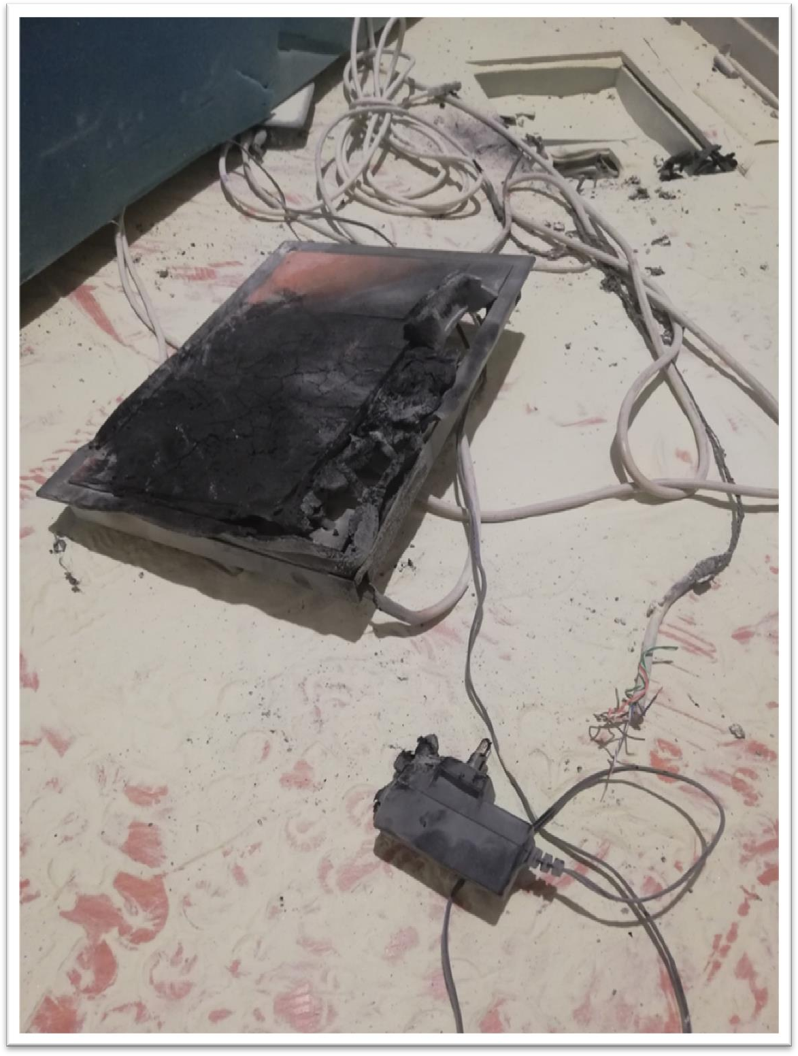
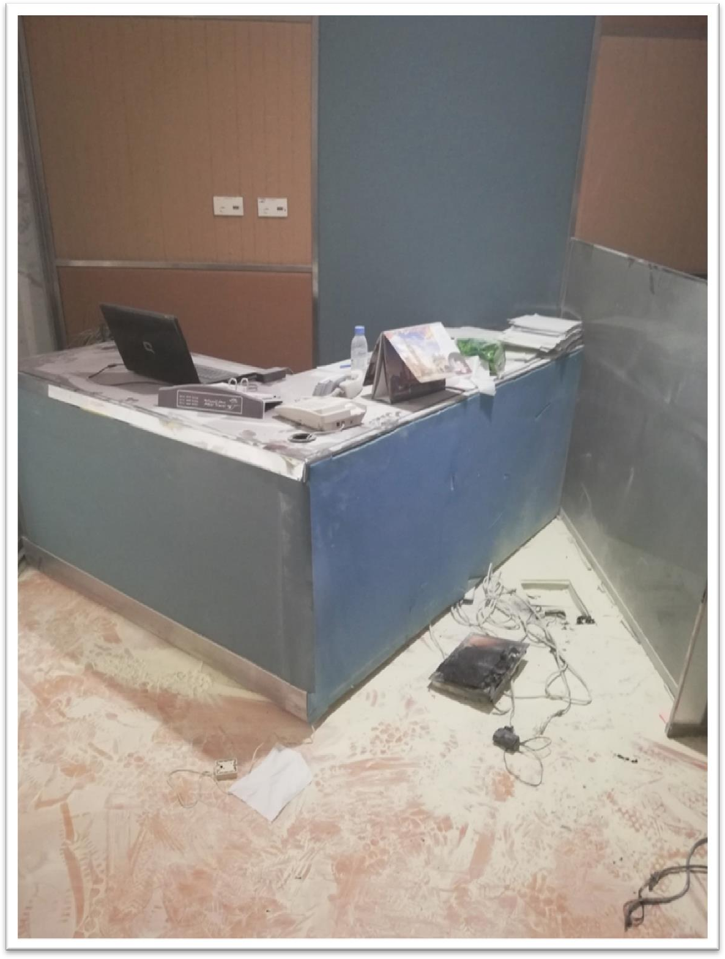
STORY 2 FIRE AT THE OFFICE DUE TO NON-COMPLIANCE
Non-compliance can lead to tragic results such as injuries, loss of property, and even loss of human lives.
In 2018, a Hospital employee did not comply with the Hospital Safety Standards and used substandard low-quality electrical equipment which led to a fire in the office.
7 of 19

Slide 7
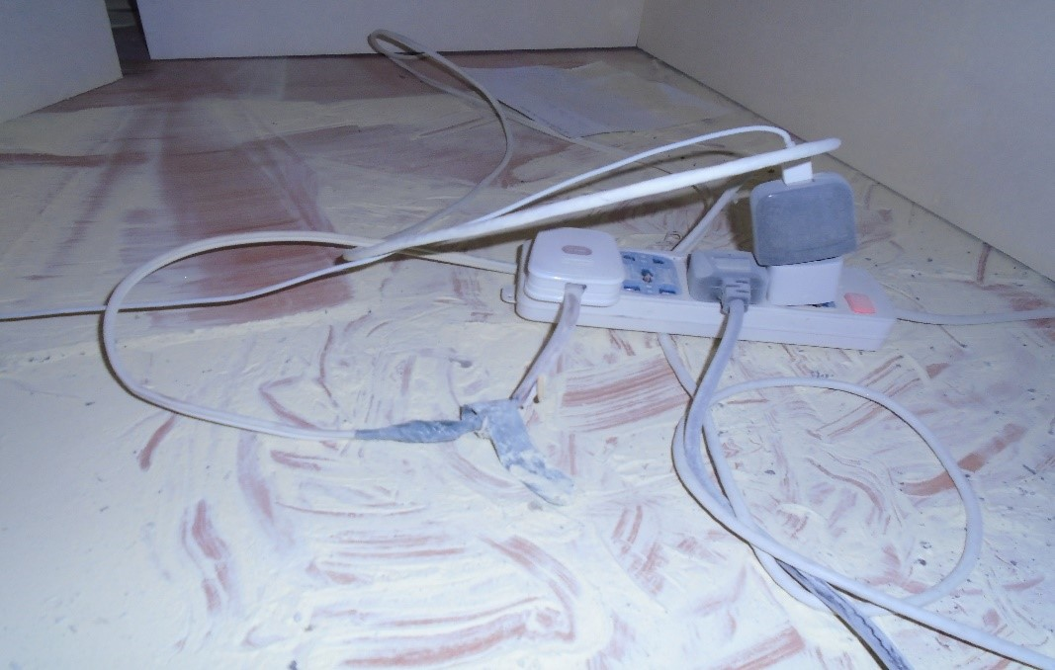
FIRE AT THE OFFICE DUE TO NON-COMPLIANCE WITH SAFETY STANDARDS
8 of 19

Slide 8
COMPLIANCE OBLIGATIONS AND OBLIGATIONS OWNERS
What are Compliance Obligations? Requirements that KFSH&RC’s Compliance Obligations Owners must comply with.
Who are Compliance Obligations Owners?
All KFSH&RC Departments are accountable for complying with the Mandatory and Voluntary compliance obligations.
9 of 19
Notes:
Compliance Obligations and Compliance Obligations Owners

Slide 9
MANDATORY INTERNAL & EXTERNAL REQUIREMENTS
Royal Orders, Rules or Guidance Issued by Regulatory Entities
Judgment of Courts
Laws and Regulations
Permits, licenses or other Forms of Authorization
Bylaws, Administrative Policies and Procedures
Strategic Partnerships and Alliances
Contracts and Purchase Orders
10 of 19

Slide 10
ROLE OF THE COMPLIANCE DIVISION
The Compliance Division aims to safeguard the Hospital from any
reputational, legal, ethical, and financial damages by ensuring
that
All applicable governmental laws, regulations, and policies & procedures
are applied within the Hospital
All employees are compliant with Compliance Obligations whether
externally or internally
All employees are aware of the consequences of Non-Compliance
All applicable Compliance Obligations are reflected within the Departments, business practices, policies, procedures, and daily Hospital operations
11 of 19

Slide 11
COMPLIANCE DIVISION ACTIVITIES
Communicating the Compliance Obligations to the Compliance Obligations Owners
Conducting Compliance Assurance Reviews (CAR)
Developing and Monitoring Compliance Obligations Response Plans (CORPs)/ (Corrective Actions)
Reporting the Compliance Level to the Executive Management
12 of 19

Slide 12
COMMUNICATING WITH THE COMPLIANCE OBLIGATION OWNERS
Responsible to communicate all applicable Compliance Obligations to the Compliance Obligations Owners
Support them in implementing them into their daily operations.
13 of 19

Slide 13
COMPLIANCE ASSURANCE REVIEWS (CAR)
Conduct Compliance Assurance Reviews (CAR) as part of the Compliance Assurance Program by conducting visits to monitor and report the compliance levels across the Hospital
14 of 19

Slide 14
COMPLIANCE OBLIGATIONS RESPONSE PLANS (CORPS)/(CORRECTIVE ACTIONS)
Non-compliant act/incident is detected
Compliance Obligation Owners develop action plans to correct it in order to eliminate the cause(s) of non-compliance and to prevent its recurrence
Compliance Division will monitor/follow-up the implementation of (CORPs)/ corrective actions
Report CORP status and level of compliance to KFSH&RC Executive Management
15 of 19

Slide 15
REPORTING TO THE BOARD
The Compliance Division will provide the Board of Directors through the Executive Management with quarterly reports to present the Compliance level in all Hospital departments.
16 of 19

Slide 16
COMPLIANCE LIBRARY
The electronic format of the library is Microsoft Access, and the user access is limited to the Compliance Division’s employees.

Slide 17
The Library Workflows
COMPLIANCE LIBRARY

Slide 18
Compliance Obligation Source Documents
COMPLIANCE LIBRARY

Slide 19
Reports Home Page
COMPLIANCE LIBRARY

Slide 20
COMPLIANCE LIBRARY
It’s just a temporary solution until the e-GRC system is in place.

Slide 21
SPEAKING UP
All employees are encouraged to report any matters or issues about a non-compliance
Don’t keep it to yourself
SPEAK UP!
17 of 19

Slide 22
QUESTIONS
Thank you.

