Slide 1
Safe Health Works, Safe Patients

Slide 4
Other Activities
Posters with motivational notes about staff roles in patient safety, posted in all hospital screens
Executive Rounds: Focused on Staff Safety ( patient family member can be included in that rounds)
Lightening the hospital with orange color
Patient safety “Extra Dose” (awareness week): several lectures that given as part of the patient safety week ( QM, QI)
Overhead massages to staff
Staff safety kit ( give away to staff) Hand sanitizer, mask holder, safety Key and reusable mask with the logo
Voice notes to be combined in a video or slide show from patients to our staff
Ask Quality!: using a social media platform to get questions from staff
Staff life during Telework: a comedy sketch about working at home ( to embrace the challenges in funny and entertaining way)

Slide 5
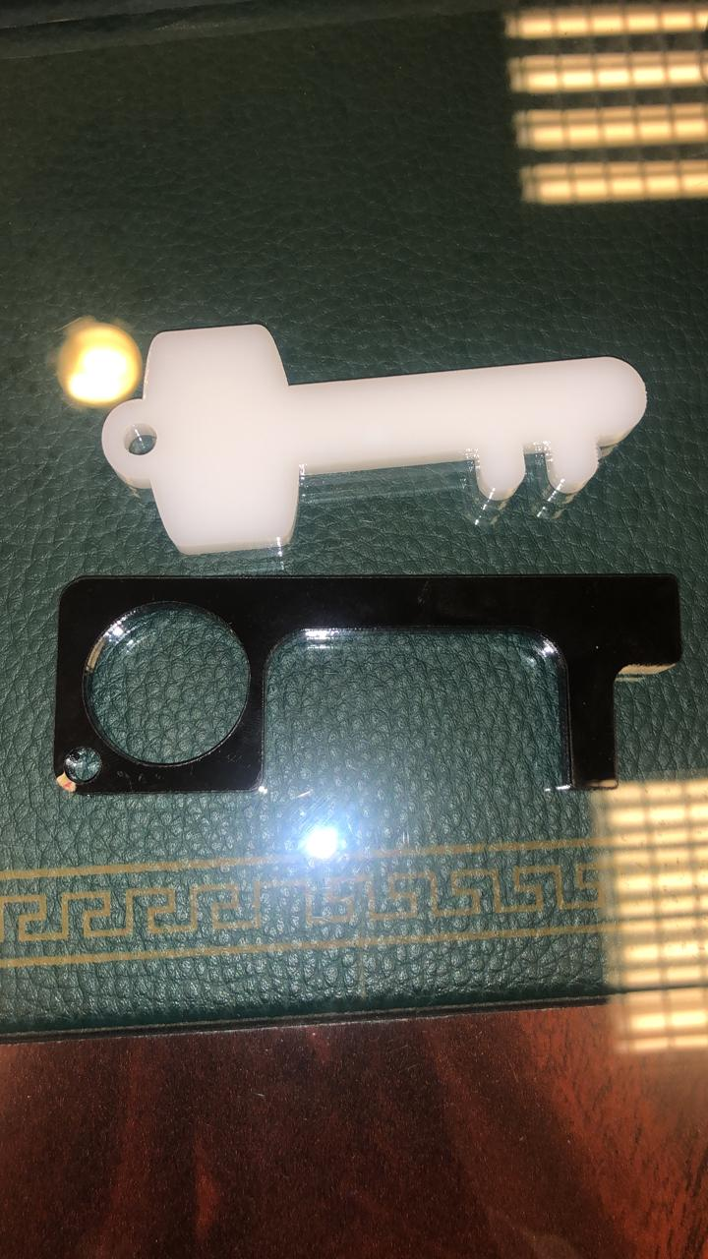
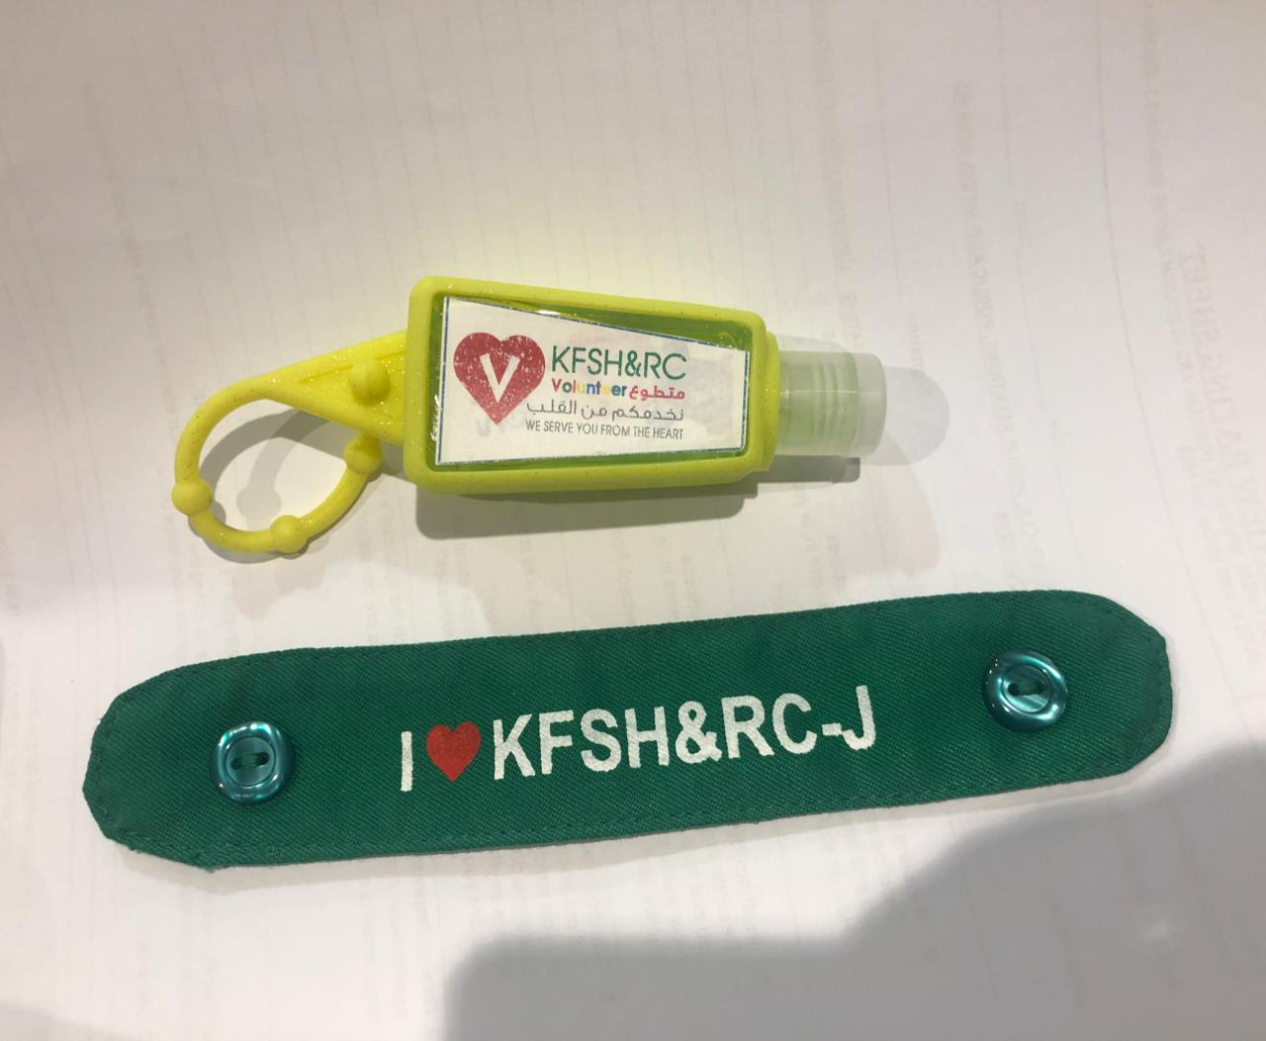
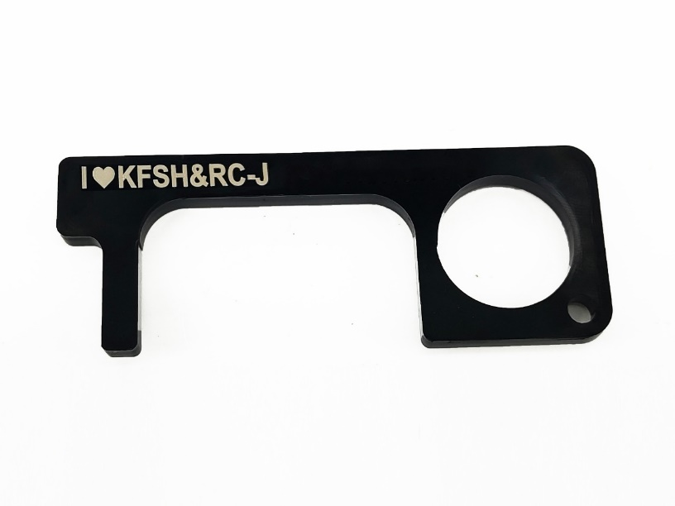
Samples Of Gifts

