Slide 1
Pareto Chart
QM 2017

Slide 2
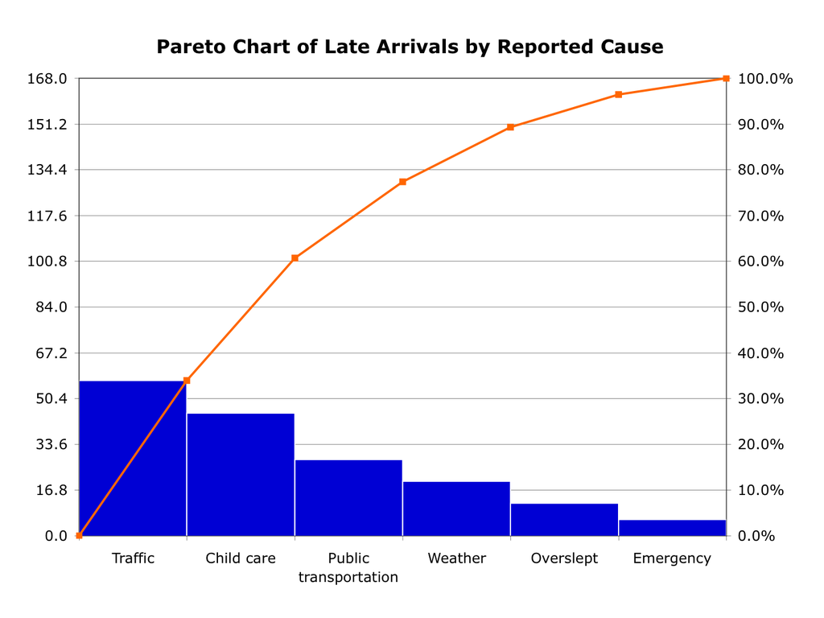
What is Pareto Chart?
A Pareto chart, named after Vilfredo Pareto, is a type of chart that contains both bars and a line graph, where individual values are represented in descending order by bars, and the cumulative total is represented by the line.

Slide 3
When to use Pareto Chart?
When to Use a Pareto Chart. When analyzing data about the frequency of problems or causes in a process. When there are many problems or causes and you want to focus on the most significant. When analyzing broad causes by looking at their specific components.

Slide 4
What is Pareto Chart in Six Sigma?
A Pareto Chart depicts the frequency with which certain events occur. It is a bar graph where each frequency (or frequency range) is shown in a descending order of importance of data, from left to right. This is based on the Pareto Principle, also called 80-20 rule or rule of vital few.

Slide 5
What is the relation of Pareto Chart to Quality?
The Pareto chart is one of the seven basic tools of quality control.
Cause-and-effect diagram (also called Ishikawa or fishbone chart): Identifies many possible causes for an effect or problem and sorts ideas into useful categories.
Check sheet A structured, prepared form for collecting and analyzing data; a generic tool that can be adapted for a wide variety of purposes.
Control charts Graphs used to study how a process changes over time.
Histogram The most commonly used graph for showing frequency distributions, or how often each different value in a set of data occurs.
Pareto chart Shows on a bar graph which factors are more significant.
Scatter diagram Graphs pairs of numerical data, one variable on each axis, to look for a relationship.
Stratification A technique that separates data gathered from a variety of sources so that patterns can be seen (some lists replace “stratification” with “flowchart” or “run chart”).

Slide 6
Thank you

