Slide 2
Notes:
Good morning,
Thank you all for joining us today as we start celebrating the World Patient Safety day
King Faisal Specialist Hospital and Research center has proudly collaborated annually with the WHO and SPSC to share the different themes that has been selected.
Our objectives during the upcoming 7-day-long activities is to:
RAISE awareness of the medication-related harm and ADVOCATE urgent actions to improve medication safety.
ENGAGE all staff in the efforts to prevent medication errors and unsafe practices.
EMPOWER patients and families to be actively involved in the safe use of medication.
Please welcome our respected Patient Safety and Risk Management Committee chair to officially open the event.

Slide 3
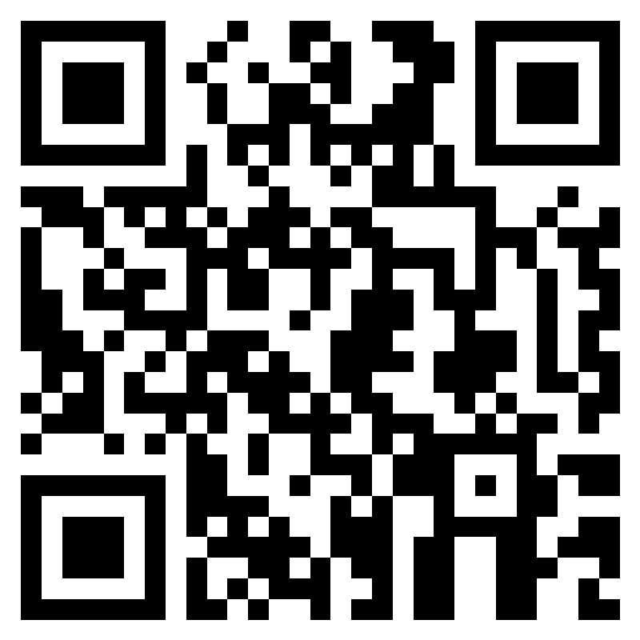
Scan for Attendance
https://forms.office.com/r/xfbHPLpQFH
Notes:
Good morning,
Thank you all for joining us today as we start celebrating the World Patient Safety day
King Faisal Specialist Hospital and Research center has proudly collaborated annually with the WHO and SPSC to share the different themes that has been selected.
Our objectives during the upcoming 7-day-long activities is to:
RAISE awareness of the medication-related harm and ADVOCATE urgent actions to improve medication safety.
ENGAGE all staff in the efforts to prevent medication errors and unsafe practices.
EMPOWER patients and families to be actively involved in the safe use of medication.
Please welcome our respected Patient Safety and Risk Management Committee chair to officially open the event.

Slide 4
World Patient Safety Day Program Opening Ceremony Sunday, 11 September, 2022 Medication Safety “Medication without Harm”
Time | Duration | Topic | Presenter
10:05 - 10:10 | 5 min | Opening Remarks | Prof. Wasil Jastaniah
10:10 - 10:15 | 5 min | (The Purple one looks yummy!) | Public Figure
10:15 - 10:35 | 20 min | Medication Safety Talk | Dr. Nezar Bahabri
10:35 - 10:55 | 20 min | Human Factor Engineering | Dr. Shatha Samman
10:00 - 10:05 | 5 Min | Medication Morning Talk Teaser | Ms. Lojain Khalid
10:55 - 11:30 | 35 min | Q&A

Slide 5
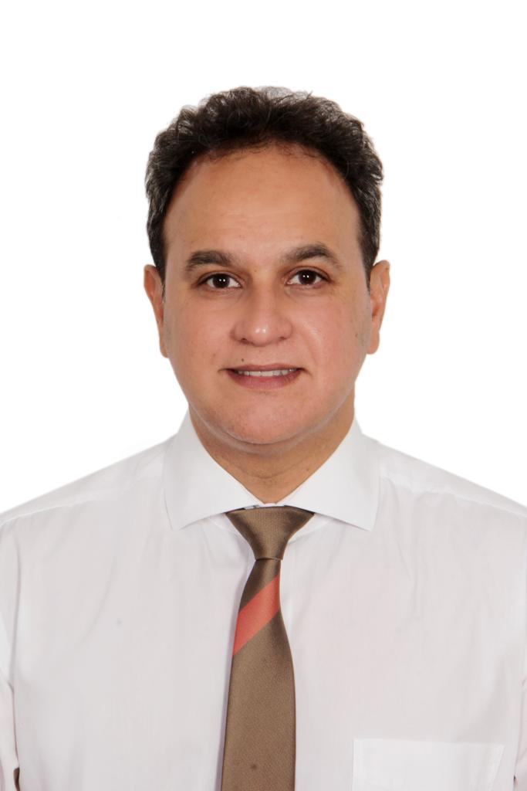
Prof. Wasil Jastaniah
MD, MBBS
Chairman Patient Safety and Risk Management Committee
Chairman Oncology
Chairman Comprehensive Cancer Care Committee

Slide 6
World Patient Safety Day Program Opening Ceremony Sunday, 11 September, 2022 Medication Safety “Medication without Harm”
Time | Duration | Topic | Presenter
10:05 - 10:10 | 5 min | Opening Remarks | Prof. Wasil Jastaniah
10:10 - 10:15 | 5 min | (The Purple one looks yummy!) | Public Figure
10:15 - 10:35 | 20 min | Medication Safety Talk | Dr. Nezar Bahabri
10:35 - 10:55 | 20 min | Human Factor Engineering | Dr. Shatha Samman
10:00 - 10:05 | 5 Min | Medication Morning Talk Teaser | Ms. Lojain Khalid
10:55 - 11:30 | 35 min | Q&A
Notes:
As a tertiary hospital, we realize our patients and family members may struggle managing the treatment provided by the healthcare members at home
There’s no doubt that the intention of giving them these large numbers of pills and capsules is to help their complex medical conditions
Looking at this video I’m about to play, we’re imagining a funny but relatable scenario from a patient dealing with polypharmacy situation:

Slide 7
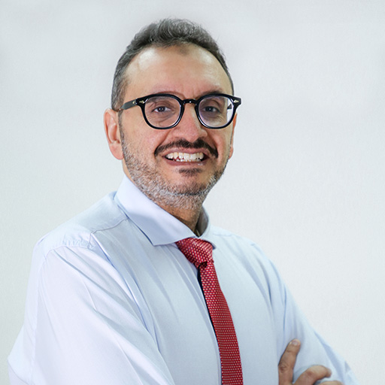
Dr. Nizar Bahabri
Chief Medical Officer, Samir Abbas Hospital

Slide 8
World Patient Safety Day Program Opening Ceremony Sunday, 11 September, 2022 Medication Safety “Medication without Harm”
Time | Duration | Topic | Presenter
10:05 - 10:10 | 5 min | Opening Remarks | Prof. Wasil Jastaniyah
10:10 - 10:15 | 5 min | (The Purple one looks yummy!) | Public Figure
10:15 - 10:35 | 20 min | Medication Safety Talk | Dr. Nezar Bahabri
10:35 - 10:55 | 20 min | Human Factor Engineering | Dr. Shatha Samman
10:00 - 10:05 | 5 Min | Medication Morning Talk Teaser | Ms. Lojain Khalid
10:55 - 11:30 | 35 min | Q&A

Slide 9
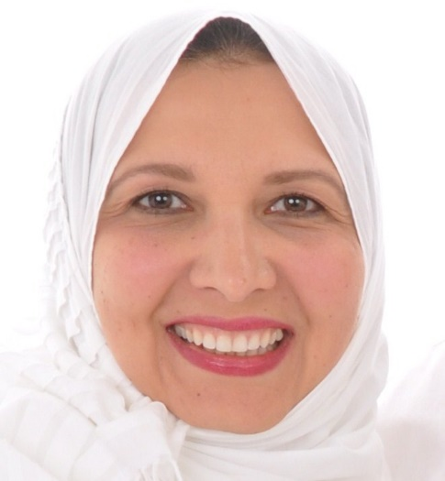
Dr. Shatha Samman
Human Factors Engineer and Research Scientist
President HFES GCC, Founder HFE Global Assessment

Slide 10
World Patient Safety Day Program Opening Ceremony Sunday, 11 September, 2022 Medication Safety “Medication without Harm”
Time | Duration | Topic | Presenter
10:05 - 10:10 | 5 min | Opening Remarks | Prof. Wasil Jastaniah
10:10 - 10:15 | 5 min | (The Purple one looks yummy!) | Public Figure
10:15 - 10:35 | 20 min | Medication Safety Talk | Dr. Nezar Bahabri
10:35 - 10:55 | 20 min | Human Factor Engineering | Dr. Shatha Samman
10:00 - 10:05 | 5 Min | Medication Morning Talk Teaser | Ms. Lojain Khalid
10:55 - 11:30 | 35 min | Q&A

Slide 11
Medication Morning Talk
Teaser Video

Slide 12
Q&A

Slide 13
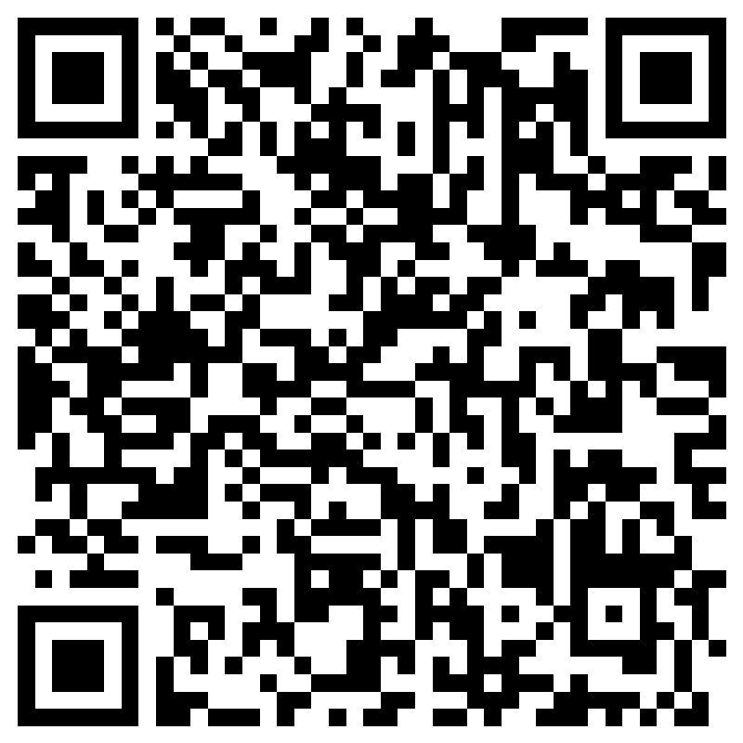
Scan for Evaluation
https://forms.office.com/r/tXkyuX28T1

